Slide 1

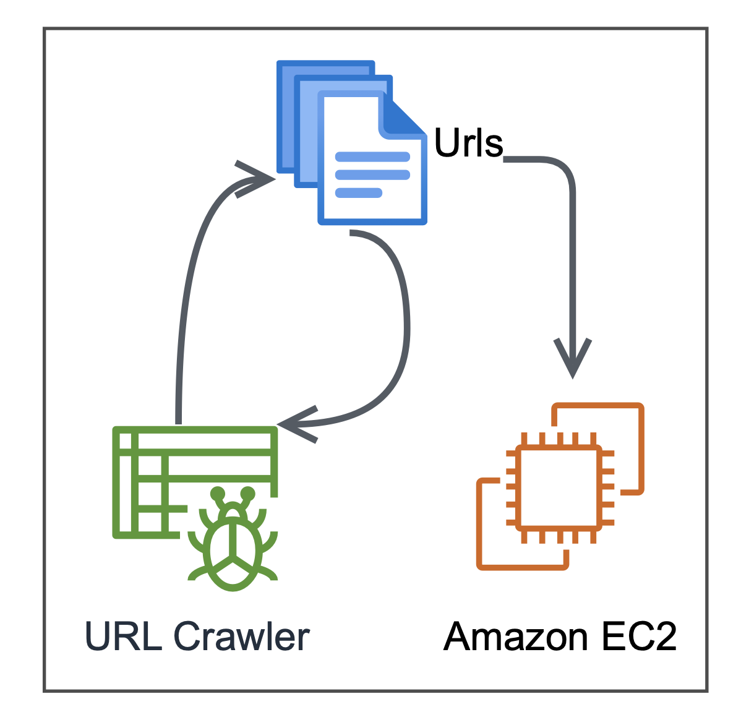
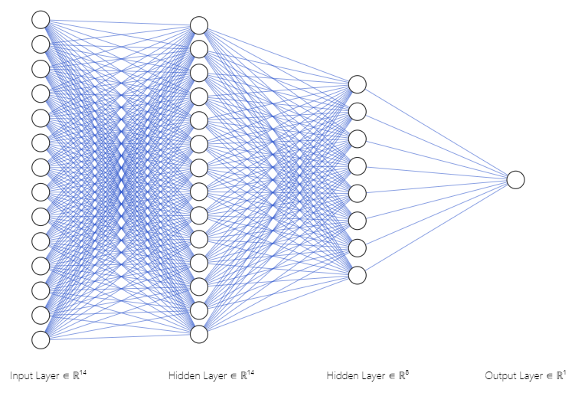
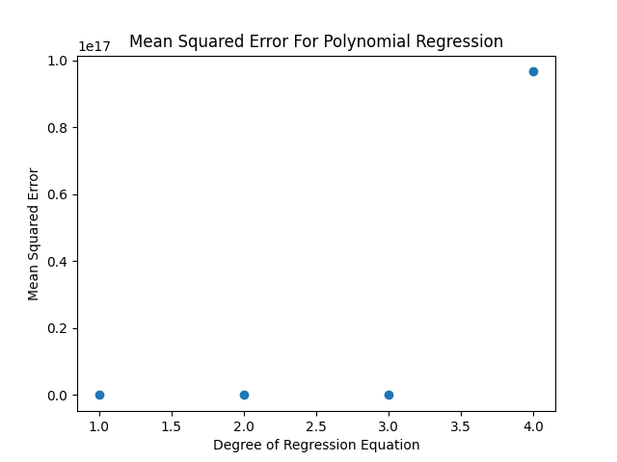
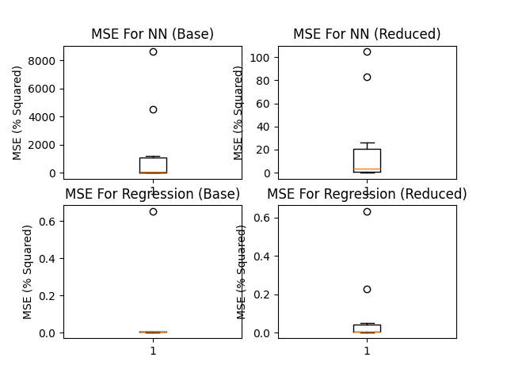

Machine Learning Approaches to Stock Prediction
Predicting 7 Day Price Change
Sebastian Criado
Background
Methodology
Goal
Results
Nowadays, it often seems like one of the least predictable elements of the financial world is the stock market. Earnings and profits often fluctuate and vary seemingly at random, but always seem to have underlying logic when the state of a company or organization is looked at. We theorized that one measure of a stock’s current valuation, the 7-day-price reaction, which evaluates the stock’s net improvement over 7 days, could be predicted by various financial factors using differing machine learning techniques. If this were possible, it would make sound financial decisions based on data far more accessible to everyday users without a comprehensive finance background, and thus make investments safer.
Multi Layer NN
Quadratic Regression
A two-sample t-test was carried out between the selective data and the raw dataset MSEs across 10 trials to attempt to see if we could discern a statistically significant difference in performance. When comparing the reduced factors and base dataset, there were p-values of .1142 and .78 respectively for the NN and Regression models, showing no statistically significant difference between the reduced and full datasets.
When comparing model performance on each dataset (one per each category of data), two sample t-tests yielded p-values of .08 for the reduced factors dataset and .11 for the full dataset. This implies that the NN/Quadratic regression models are comparable but does not tell the full story. Below are distribution graphs for each model type and dataset, which clearly show that both the range and standard of deviation for the regression approach consistently yielded a lower MSE.
Due to the complexity of financial trends and the apparent external randomness of the stock market, we theorized that a multi-layer neural network would be most capable of understanding trends many humans cannot easily identify. As such, we created a basic model architecture (shown below) using an Adam optimizer and a basic 2-layer neural network and trained it with an 80/20 split on our data subsets. After experimentation, we decided to use an epoch count of 10, set learning rate of .001, using the Tensorflow framework. To maintain as much consistency with our quadratic regression model as possible, we used Mean Squared Error (MSE) as both our loss function and accuracy metric for model evaluation.
We realized as well that we were making a large assumption that the data would be complex and therefore would require a more complex model and decided to experiment with a relatively simpler quadratic model as a result. As quadratic regression does not require much hyperparameter tuning, we simply had to determine a best fit degree for the equation fitting our data. To do so, we ran experiments up to a 10th degree quadratic equation, attempting to minimize MSE across 10 training runs. After experimentation, to our surprise, a 1st degree quadratic regression (making this in effect, a linear equation), was proving consistently to be the best fit, so we focused on improving this model as a result.
Hypothesis
Introduction
A set of factors from the dataset we chose to work with exists that can predict price reaction to a high degree of accuracy.
Some of this data could be marked as unnecessary for analysis, and models excluding this data would be able to predict 7D price reaction better than models trained using all the factors.
Due to the complex nature of the data, a more complex model, such as a multi-layer neural network, will learn the data trends better than a more simplified quadratic regression model
Dataset
When looking at the data, I believe that the large number of outliers with the NN data affected our ability to draw a strong statistically significant data despite the clearly lower error of the regression approach.
As a result of this analysis, we are clearly able to make the claim that this data does lend itself to prediction of stock movement and 7-day price range. However, we cannot make the claim that any of the factors can be eliminated to provide modeling improvements. In addition, while we cannot claim to have provided statistically significant evidence, the results imply that a simpler regression-based approach yields better accuracy than the NN one.
This project used data from the LSEG Refinitiv database, a student accessible database that hosts the records of several top companies from their quarterly earnings calls. Along with being easily accessible, the data columns were fairly standardized across the entire dataset, with all the units and data columns being kept consistent and included several fairly acknowledged financial factors as well as the resulting 7-day price reaction. However, As some companies sometimes did not report some data columns, such as the SmartEstimate, we experimented with both zeroing out or eliminating those rows altogether and found that zeroing provided overall better practical accuracy. While this is not necessarily representative of the true values, it yielded better accuracy.
To create the dataset we ended up using, we merged about 50 individual company report datasets by iterating through and creating a column based ordered dictionary, where for example, entry 5 of the dictionary corresponding to the Surprise % would correspond to a single quarter for a single company.
Future Work
Data Segmentation
Model Testing/Analysis
Challenge
After determining which factors we wanted to eliminate for hypothesis 2, we then ran a set of 10 trials on each model, re-training and shuffling the data every trial. For each testing run, 80% of our total shuffled dataset was used as a training set, and the remaining data was held back for validation and testing at the end of each run. Our goal with this was to eliminate any lucky combinations or variability from our method analysis, as well as to deal with the possibility of outlier data. Since we were comparing populations and samples against each other, when comparing inter model results or models trained with the different categories of data, 2 sample t tests were used for all model comparisons to evaluate statistical significance.
To test our hypothesis that a set of factors from earnings call data could be excluded, we went through the data and determined factors that might be reasonable derived from each other. We theorized that this data should in theory follow the same correlation in the same direction, and thus a DL model or regression coefficients would be able to simply compensate for their removal. That gave us our initial starting point for factor removal, and then we attempted from there to experiment with different factors to see how this affected model accuracy. Once we believed that the factors had been determined, a dataset consisting of the “ideal factors” was generated, and then used to train both models in additional to the complete dataset.
Ramifications and Limitations
It is very much possible that a more complex architecture may have yielded better results for the neural net, and we did only have 1000 data points, which in general is considered too few for model training. Further, despite strong evidence based on MSE, due to the variability of the NN model’s results, we cannot definitively say that the regression approach yielded better outcomes, despite it seeming clear based on the range of error

